Slide 1
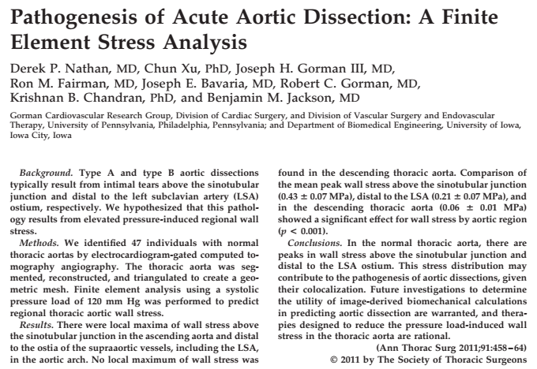

Slide 3
Can we do the same things the authors of the article did?
Yes, also more detailed and with a different computational framework. Our simulations can be more “detailed”.
Hence, which is the goal?
Let’s try to see whether, from a structural point of view, we can match the results you got from CFD on DF in different types of healthy arches.

Slide 4
Data:
15 healthy cases
5 cases of Type of Arch 1.
5 cases of Type of Arch 2.
5 cases of Type of Arch 3.
Pressure P.S. from CFD analyses.
Methods:
Apply the pipeline we developed to obtain the P.S. computational geometry of every Arch under study starting from CT images.
Divide each Arch in four zones (Zone 0 -1-2-3) according to “A geometric reappraisal of proximal landing zones for thoracic endovascular aortic repair according to aortic arch types”, by Marrocco-Trischitta, M. M., et al.
Goal:
Check the von Mises stress distribution in each zone.
For each zone, find a quantity that can summarize and be representative of the von Mises stress distribution.
Can we deduce that largest von Mises stress values can be found in landing zones with increased angulation? (i.e., Zone 3 of Type of Arch 2 and 3)

Slide 5
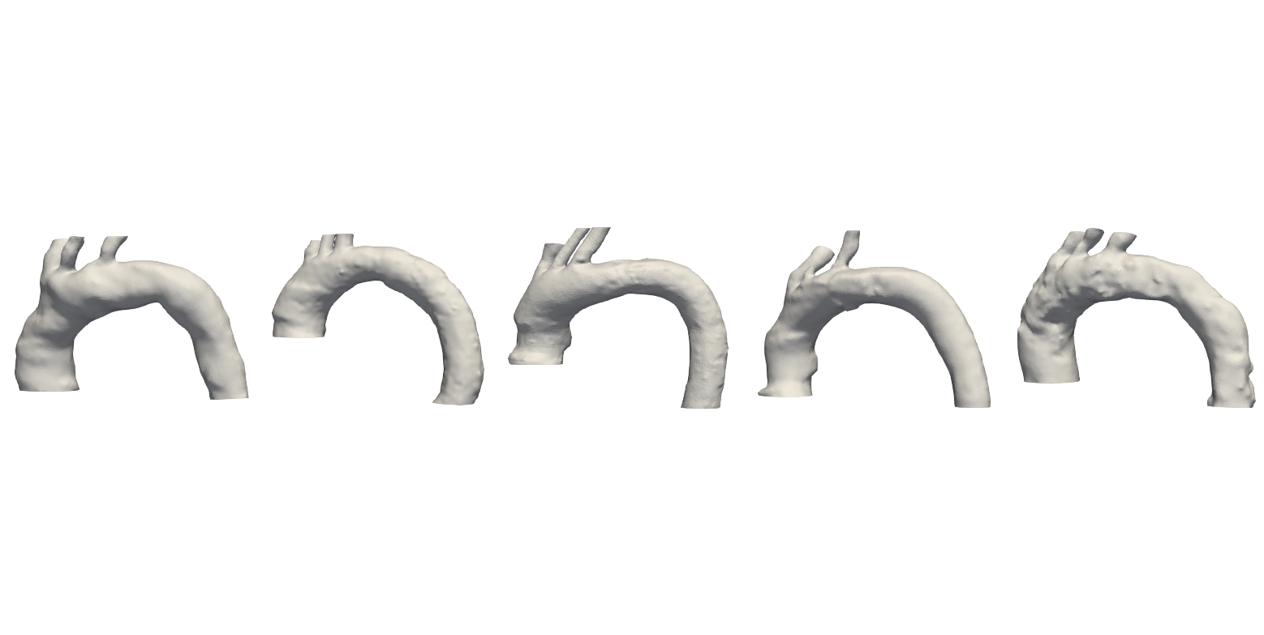
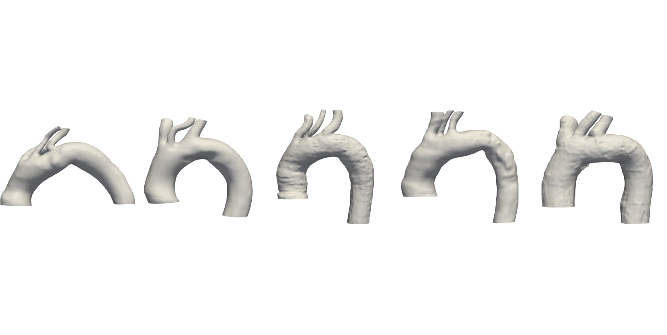
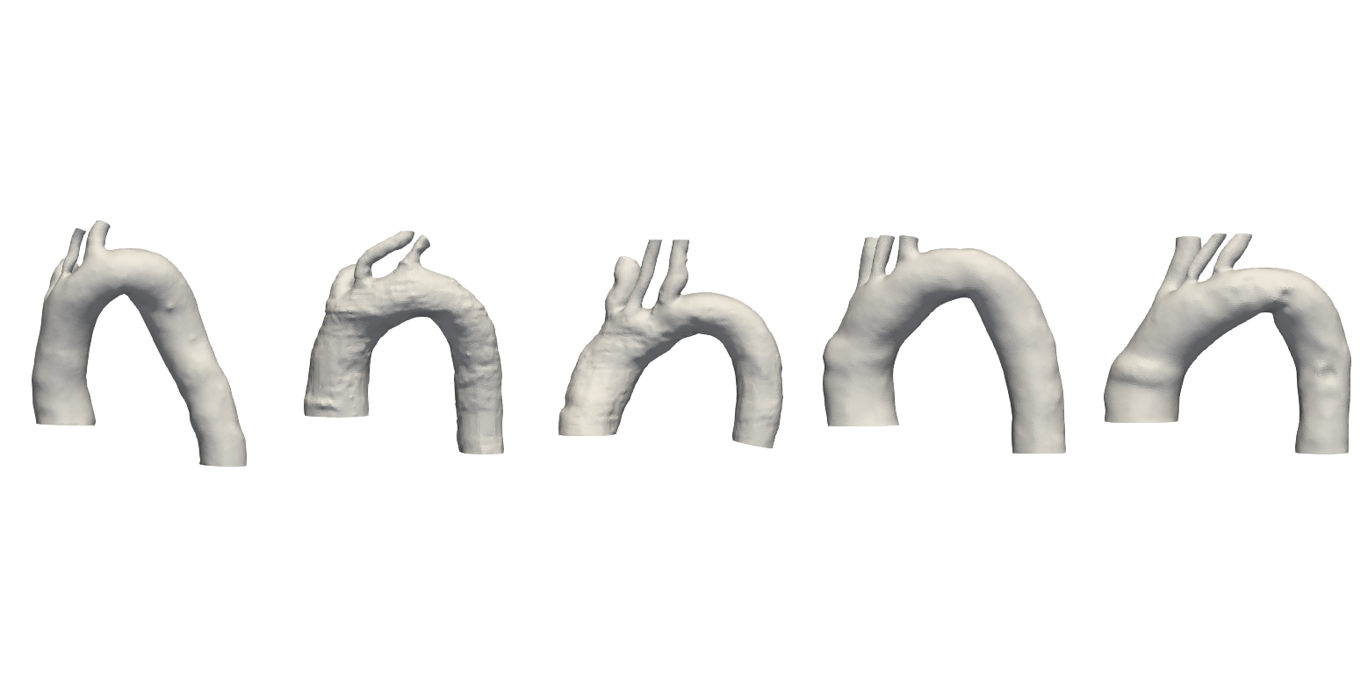
DATA
TYPE OF ARCH 1
TYPE OF ARCH 2
TYPE OF ARCH 3

Slide 6
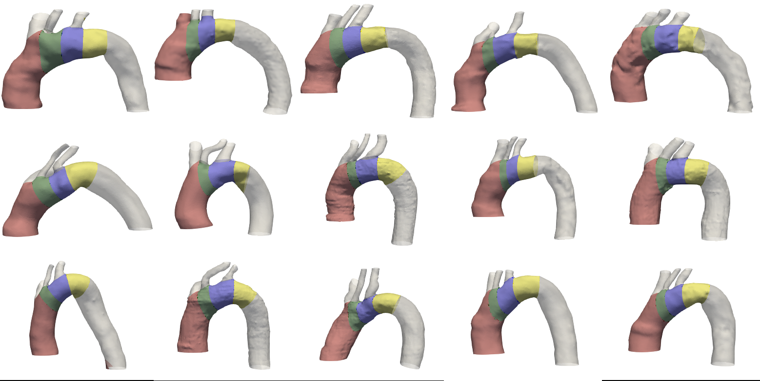
CONSIDERED LANDING ZONES: Are they OK?
1
2
3
0
TYPE OF ARCH 1
TYPE OF ARCH 2
TYPE OF ARCH 2

Slide 7
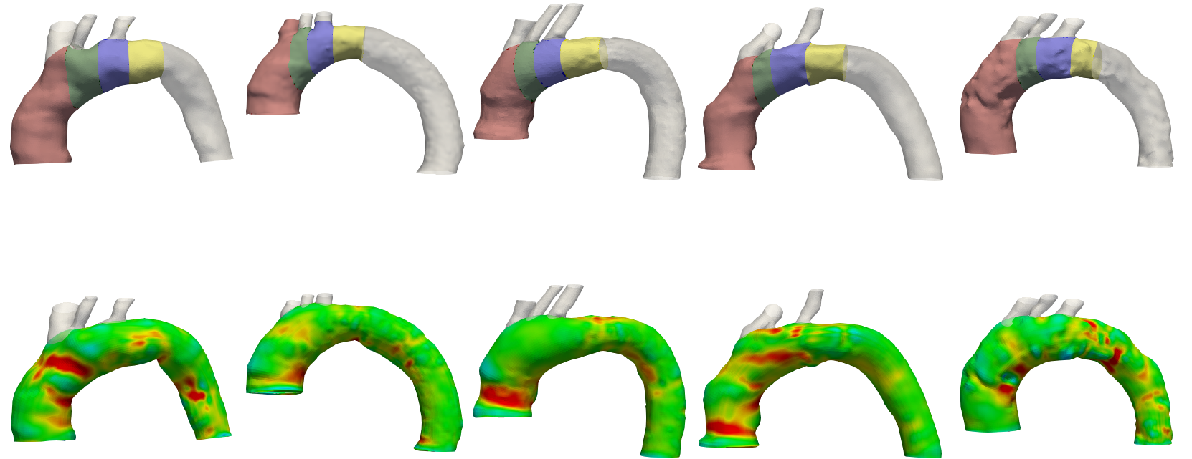
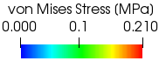
VON MISES STRESS DISTRIBUTION PER TYPE OF ARCH 1
1
2
3
0
P1_T1
P2_T1
P3_T1
P4_T1
P5_T1

Slide 8
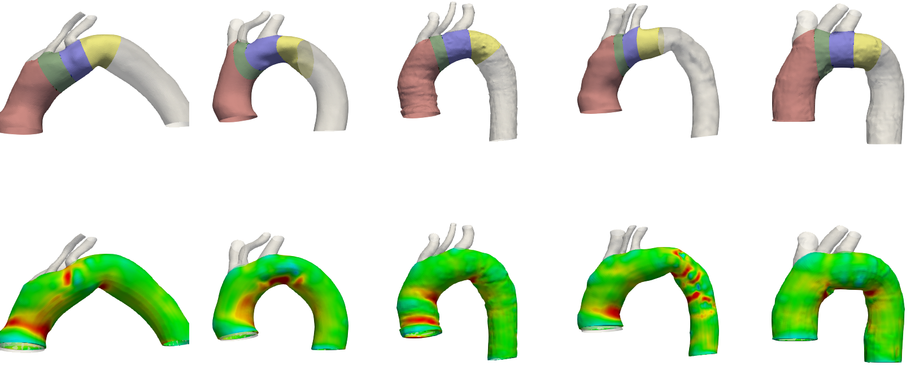
VON MISES STRESS DISTRIBUTION PER TYPE OF ARCH 2
2
3
1
0
P1_T2
P2_T2
P3_T2
P4_T2
P5_T2

Slide 9
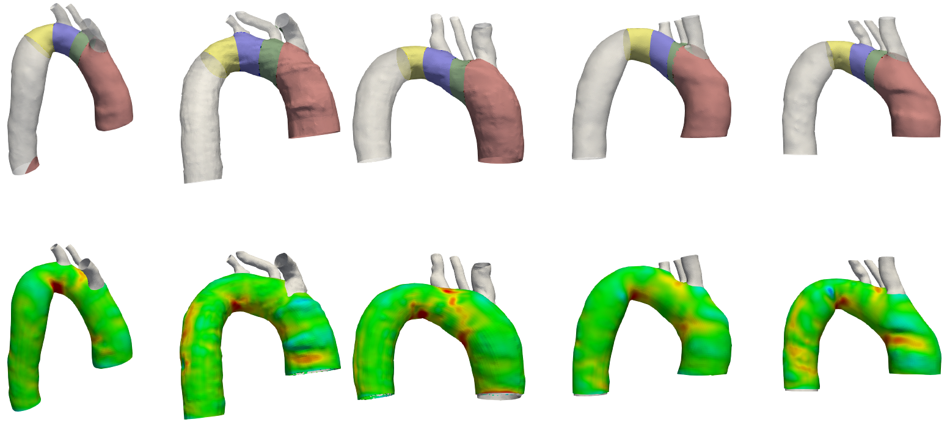
VON MISES STRESS DISTRIBUTION PER TYPE OF ARCH 3
3
2
1
0
P1_T3
P2_T3
P3_T3
P4_T3
P5_T3

Slide 10
VON MISES STRESS DISTRIBUTION

Slide 11
Which measure to use to summarize vM stress for each zone?
Let’s adopt the maximum value of the vM per zone
For each type & for each patient of a given zone
For each zone & for each patient of a given type
 | T1 | T2 | T3
ZONE 0 | 0.2668 | 0.2416 | 0.1563
 | 0.2079 | 0.1923 | 0.1815
 | 0.2330 | 0.2209 | 0.2229
 | 0.2322 | 0.2253 | 0.1920
 | 0.2413 | 0.188 | 0.1926
Mean Values per type of arch | 0.2362 | 0.2136 | 0.1891
SD values per type of arch | 0.0212 | 0.0228 | 0.0240
ZONE 1 | 0.2516 | 0.2361 | 0.1620
 | 0.1676 | 0.1728 | 0.2013
 | 0.1513 | 0.1457 | 0.2298
 | 0.2024 | 0.1742 | 0.1866
 | 0.1799 | 0.232 | 0.1887
Mean Values per type of arch | 0.1906 | 0.1922 | 0.1937
SD values per type of arch | 0.0389 | 0.0399 | 0.0247
ZONE 2 | 0.1697 | 0.2341 | 0.1806
 | 0.1606 | 0.2190 | 0.1849
 | 0.1893 | 0.1456 | 0.2428
 | 0.2125 | 0.1643 | 0.1805
 | 0.1815 | 0.193 | 0.1738
Mean Values per type of arch | 0.1827 | 0.1912 | 0.1925
SD values per type of arch | 0.0199 | 0.0368 | 0.0284
ZONE 3 | 0.1991 | 0.2584 | 0.2684
 | 0.2330 | 0.2547 | 0.2070
 | 0.2008 | 0.2408 | 0.2428
 | 0.2561 | 0.1876 | 0.2133
 | 0.2248 | 0.202 | 0.2081
Mean Values per type of arch | 0.2228 | 0.2287 | 0.2279
SD values per type of arch | 0.0238 | 0.0320 | 0.0269
 | For each patient and for each type of arch, maximum value of the von Mises stress per zone
xxxxxxxx | For each patient, maximum value of the von Mises stress over all the four zones
 | For each zone, compute mean values of the von Mises stress per type of arch
 | For each zone, Max (von Mises Stress mean values per type of arch)

Slide 12
Is the maximum value of the vM per zone the right measure to be used?
What can be seen by adopting this one?
There is NO distinguishable trend that can be highlighted. In particular, using this measure, we cannot deduce that the largest von Mises stress values can be found in landing zones with increased angulation (Zone 3, T2 & T3).
From the previous results, large vM values can be found in Zone 3 of every type of arch, but also in other zones.

Slide 13
Is the maximum value of the vM per zone the right measure to be used?
What can be seen by adopting this one? Let’s test the results we got statistically
Significance level: α = 0.05
Results
Group 2/III is not following a normal distribution.
Groups are not significantly different.

Slide 14
Can we do the same things the authors of the article did?
Yes, we did it.
Hence, which is the goal?
From a structural point of view and with our analysis settings, we cannot match the results from CFD on DF in different types of healthy arches.
What can we do now?
Let’s change the constitutive model?
Let’s change the boundary conditions?
Let’s change the quantity we consider to differentiate the different types of arches? Instead of maximum value of vM, what?

Slide 15
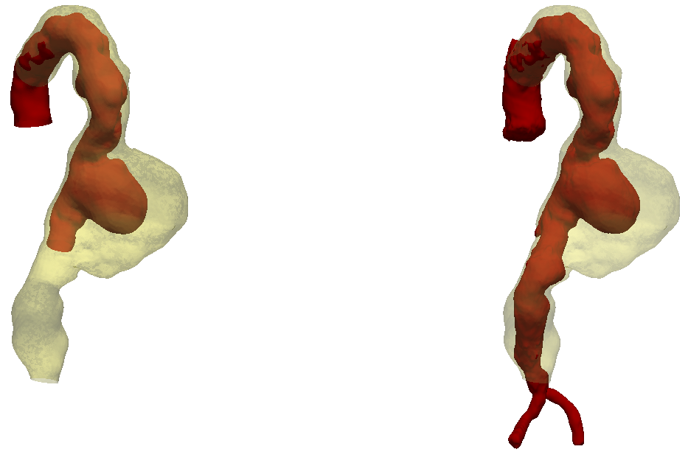
Introduction of the ILT in our analyses
Why?
Considering ILT is fundamental if we want to try to estimate aneurysm rupture risk.
A lot of studies on ILT with FEM but no one able to delineate its role.
No studies taking into account ILT and IgA.
My suggestion:
Take a patient whose ILT hasn’t increased in size. Run analyses at different (always higher) pressures.
We have a patient whose aneurysm and ILT have increased since the first CT (2010) because he is refusing treatment.
Therefore, segment lumen and ILT, run inflation analyses taking both of them into account and try to answer this question: does the ILT have a protective role with respect to aneurysm rupture or not? Let’s run analyses with increasing pressures.
I HAVE QUESTIONS ON ILT SEGMENTATION: who can I ask them?

Slide 16
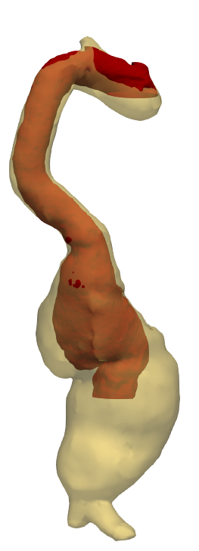

Slide 17
Is the maximum value of the vM per zone the right measure to be used?
What can be seen by adopting this one? Let’s test the results we got statistically
Employed tests:
Shapiro-Wilk: are the data following a normal distribution?
If and only if data are following a normal distribution, use t-test or one-way ANOVA to verify if significant differences exist among the groups (test their means)
If they do not follow a normal distribution, use Kruskal-Wallis test instead of one-way ANOVA to verify if significant differences exist among the groups
If Kruskal-Wallis test is used in SPSS, pair-wise comparison can not be done. Therefore, use Mann-Whitney test to verify if significative differences exist among two groups.

Slide 18
VON MISES STRESS DISTRIBUTION: SUMMARY
Max and min value of the von Mises stress for each patient and each zone
Patient | ToA | PLZ | Min vM | Max vM
P1 | 1 | 0 | 0,0382 | 0,2668
P1 | 1 | 1 | 0,0598 | 0,2516
P1 | 1 | 2 | 0,0552 | 0,1697
P1 | 1 | 3 | 0,07 | 0,1991
P2 | 1 | 0 | 0,0432 | 0,2079
P2 | 1 | 1 | 0,0843 | 0,1676
P2 | 1 | 2 | 0,0879 | 0,1606
P2 | 1 | 3 | 0,0776 | 0,233
P3 | 1 | 0 | 0,0529 | 0,233
P3 | 1 | 1 | 0,0817 | 0,1513
P3 | 1 | 2 | 0,0828 | 0,1893
P3 | 1 | 3 | 0,0715 | 0,2008
P4 | 1 | 0 | 0,0501 | 0,2322
P4 | 1 | 1 | 0,0951 | 0,2024
P4 | 1 | 2 | 0,0789 | 0,2125
P4 | 1 | 3 | 0,0537 | 0,2561
P5 | 1 | 0 | 0,027 | 0,2413
P5 | 1 | 1 | 0,0619 | 0,1799
P5 | 1 | 2 | 0,0388 | 0,1815
P5 | 1 | 3 | 0,0626 | 0,2248
Patient | ToA | PLZ | Min vM | Max vM
P6 | 2 | 0 | 0,0488 | 0,2416
P6 | 2 | 1 | 0,0845 | 0,2361
P6 | 2 | 2 | 0,0589 | 0,2341
P6 | 2 | 3 | 0,0706 | 0,2584
P7 | 2 | 0 | 0,0394 | 0,1923
P7 | 2 | 1 | 0,0763 | 0,1728
P7 | 2 | 2 | 0,0596 | 0,219
P7 | 2 | 3 | 0,0454 | 0,2547
P8 | 2 | 0 | 0,0527 | 0,2209
P8 | 2 | 1 | 0,0905 | 0,1457
P8 | 2 | 2 | 0,0593 | 0,1456
P8 | 2 | 3 | 0,0819 | 0,2408
P9 | 2 | 0 | 0,0545 | 0,2253
P9 | 2 | 1 | 0,0365 | 0,1742
P9 | 2 | 2 | 0,072 | 0,1643
P9 | 2 | 3 | 0,0801 | 0,1876
P10 | 2 | 0 | 0,047 | 0,188
P10 | 2 | 1 | 0,067 | 0,232
P10 | 2 | 2 | 0,072 | 0,193
P10 | 2 | 3 | 0,054 | 0,202
Patient | ToA | PLZ | Min vM | Max vM
P11 | 3 | 0 | 0,0308 | 0,1563
P11 | 3 | 1 | 0,0549 | 0,162
P11 | 3 | 2 | 0,0398 | 0,1806
P11 | 3 | 3 | 0,0601 | 0,2684
P12 | 3 | 0 | 0,0517 | 0,1815
P12 | 3 | 1 | 0,0599 | 0,2013
P12 | 3 | 2 | 0,0749 | 0,1849
P12 | 3 | 3 | 0,0636 | 0,207
P13 | 3 | 0 | 0,0688 | 0,2229
P13 | 3 | 1 | 0,0798 | 0,2298
P13 | 3 | 2 | 0,0725 | 0,2428
P13 | 3 | 3 | 0,0828 | 0,2428
P14 | 3 | 0 | 0,0881 | 0,192
P14 | 3 | 1 | 0,0685 | 0,1866
P14 | 3 | 2 | 0,0891 | 0,1805
P14 | 3 | 3 | 0,0755 | 0,2133
P15 | 3 | 0 | 0,0669 | 0,1926
P15 | 3 | 1 | 0,0881 | 0,1887
P15 | 3 | 2 | 0,0807 | 0,1738
P15 | 3 | 3 | 0,0305 | 0,2081
ToA: | Type of Arch
PLZ: | Landing Zone
Min vM | Minimum value of the von Mises stress [MPa] for each PLZ
Max vM | Maximum value of the von Mises stress [MPa] for each PLZ

